Slide 1
Grayce Graduate Data Consultant
By
Alexander Thompson

Slide 2

About Me
Hobbies: Gym, Fishing, Hiking, Programming.
Passions: Philosophy, Music, History, Healthy Lifestyle.
Values: Hard work, Morality, Determination, Friendship

Slide 3



Education & Skills
University of Westminster, BSc Economics
Programming Languages: SQL, R and Python
Software: Excel (Advanced), IBM SPSS, Minitab, EViews, Bloomberg Terminal
Skills: Financial/Economic Analysis, EDA, Statistics, Regression Analysis, Machine Learning, NLP, Data Engineering, APIs, Web Apps.
Soft Skills: Teamwork, Collaboration, Problem Solving, Attention to Detail, Data Storytelling
Notes:
Note: Process Optimisation

Slide 4




My Experiences
University: Policy Analysis, Regulatory Economics(Ofgem), Strategy Review (Sony), Malware Detection (Google Workspace).
Independent: EDA, Machine Learning (TikTok, Waze, etc), NLP, Web Scrapping, Web Applications

Slide 5
Why Grayce?
Data-driven consultancy fits my career goals
Apply data skills in real client environments
Consultancy suits my strengths
Values that align with how I work

Slide 6
Data Skills
Let's have a look at my data skills in action with some case studies.
We will start by looking at a successful company, including the factors that led to their success and how they adapted and transformed over time.
For this we will be looking at NVIDIA.

Slide 7


NVIDIA
Founded on April 5, 1993, by Jensen Huang, Chris Malachowsky and Curtis Priem.
Focused on Graphic Processing Units (GPUs) for video games and workstations applications.
Adapted GPUs potential to other emerging markets such as AI and Supercomputing.
They now develop hardware and software for accelerated computing.
They are the 7th US company to reach $1 Trillion valuation. (Yahoo Finance, 2023)
First company to go past $4 Trillion valuation. (Forbes, 2024)

Slide 8
How they became successful?
NVIDIA didn’t limit their horizons to gaming, they realised and adapted their technology for the future of computing e.g. crypto mining and AI.
Invested early into AI and Accelerated computing before demand rose, e.g. CUDA.
Transformed their business model from selling components to full AI infrastructure and services.
NVIDIA story highlights the value of innovation, thinking ahead and adapting early.
But there is one more factor … the AI Boom.
Notes:
Note: Accelerated computing e.g. Crypto Mining

Slide 9
The AI Boom
The AI Boom in the early 2020’s, led to a significant increase in the demand for AI data centres and its hardware.
AI models need fast GPUs because they process huge calculations in parallel, making training and inference faster and more efficient.
NVIDIA had already developed Deep GPU Xceleration (DGX) supercomputers in 2016. (TechCrunch, 2016)
These are used for high-performance AI computing platforms to be used in data centres to train and deploy advanced AI models.
This demand for AI data centres hardware led to NVIDIA becoming the first company in the world to reach $5 Trillion valuation.
As of 2027 Q1 Fiscal Year, NVIDIA recorded a revenue of $81.6 Billion, with $75.2 Billion coming from data centre revenue. (NVIDIA, 2026)

Slide 10
NVIDIA Revenue

Slide 11
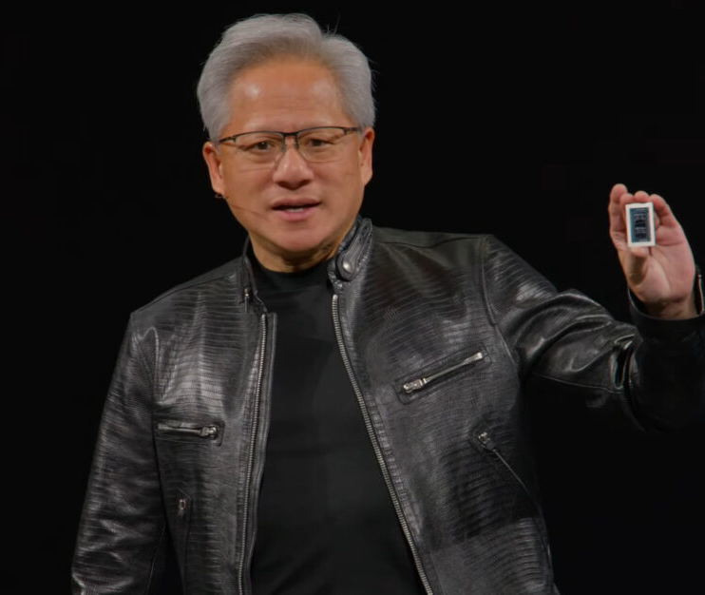
NVIDIA Currently
On 1st June 2026, at their GPU Technology Conference (GTC), unveiled their new superchip the RTX Spark. (Yahoo Finance, 2026)
Marks NVIDIA’s move into the PC processor market, expanding beyond GPUs and data centres.
RTX Spark will power AI PCs from Dell, Lenovo, Asus and more.
Designed to bring high-performance AI computing into compact devices.
NVIDIA’s share price increased by 6.3% in a day.

Slide 12
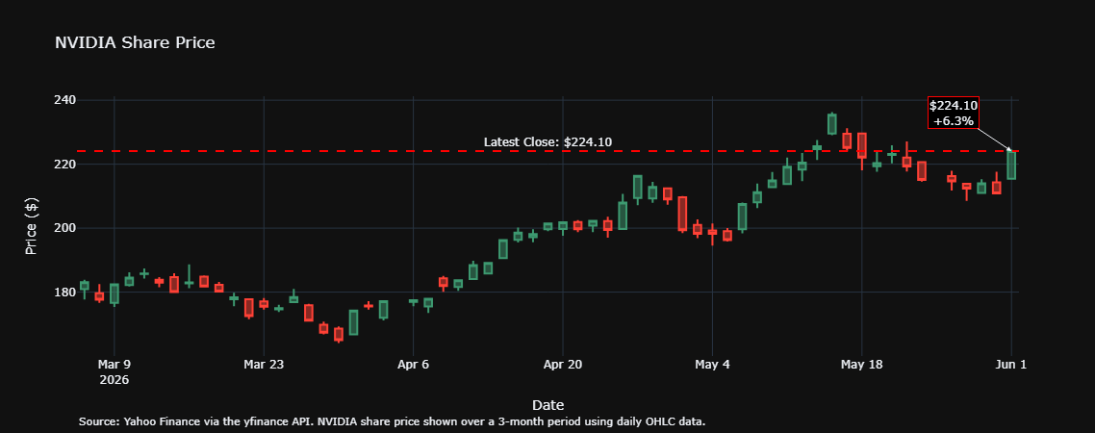
NVIDIA Share Price
In response to this, Intel’s share price fell by 4.7% in the same day.

Slide 13
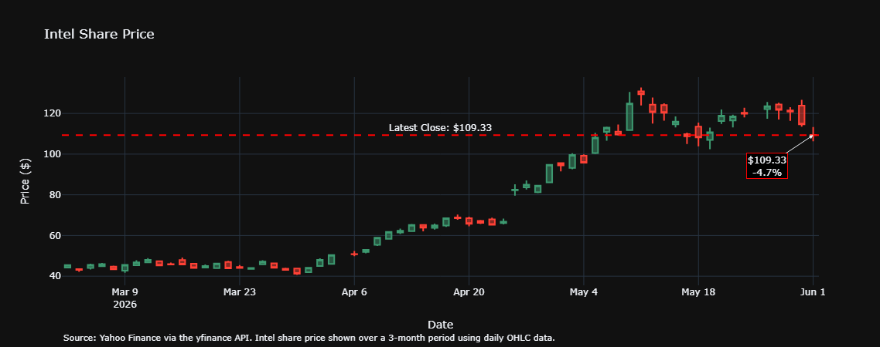
Intel Share Price
This brings us onto our next case study about a company that failed to adapt, Intel.

Slide 14
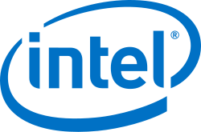

Intel
Founded on 18th July 1968 by Gordon Moore and Robert Noyce.
They design and manufacture Central Processing Units (CPUs) as well as chipsets, GPUs and much more.
Wintel, the partnership with Microsoft from the 1990s which made them the dominant supplier of CPUs.
Intel supplies the microprocessors for most computer systems manufacturers, with 90% of Office PCs using these at one time.
One of the developers of the x86 architecture that is found in most PCs and currently leads the market in this.

Slide 15
Intel’s Struggle to Adapt
Intel struggled with manufacturing and execution challenges.
Risk-averse culture weakened transformation speed. (Reuters, 2024)
Market share declined as AMD, NVIDIA and Apple gained ground.
Over-reliance CPUs, while demand shifted towards GPUs, specialised chips and AI Accelerators.
Slow to invest and adapt to the AI boom and utilise the potential of their technology.

Slide 16
Intel’s Performance
Q1 2026 revenue: $13.6 Billion with $5.1 Billion from data centre revenue. (Intel, 2026)
NVIDIA data centre revenue: $75.2 Billion, showing the gap in AI Infrastructure.
Intel’s market value remains low, reflecting weaker investor confidence.
Revenue fallen from 2020-2021 peak, highlighting the cost of slower adaptation.

Slide 17
Intel and NVIDIA
On the 8th of November 2024, Intel left the Dow Jones Industrial Average and was replaced with NVIDIA. (Reuters, 2024)
In September 2025, NVIDIA invested $5 Billion as part of a partnership to co-develop data centres and PC CPUs.
Enables Intel x86 CPUs to integrate with NVIDIA’s AI and data centre platforms.
NVIDIA agreed to buy Intel shares at $23.28 per share.
Recent NVIDIA product announcements highlight growing competition in areas where Intel has traditionally been strong.

Slide 18
NVIDIA vs Intel: Diverging After the AI Boom
NVIDIA capitalized on the AI Boom through early investment in GPUs and data centre infrastructure.
Intel struggled to keep pace, with revenue remaining comparatively flat after slower adaption to AI acceleration.

Slide 19
Resources
To see how I extracted, transformed and loaded the data via web scraping and APIs, view the notebook here
NVIDIA’s quarterly revenue
NVIDIA’s share price 3-months
NVIDIA Excel Workbook
Intel’s quarterly revenue
Intel’s share price 3-months
Intel Excel Workbook

